Slide 1
MODULE 5
Basics of Counting - Addition principle, multiplication principle, counting using cases
Permutations - Factorial notation, arrangements, permutations with and without repetition
Combinations- Selection, combinations without repetition, relationship between permutations and combinations
Pigeonhole Principle - Basic principle, generalized pigeonhole principle, applications
Inclusion–Exclusion Principle - Two-set and three-set formulas, counting overlapping sets,
Mathematical Induction - Principle of induction, base case, inductive hypothesis, inductive step

Slide 2
Basics of Counting
The fundamental principle of counting is a basic concept used to determine the total number of possible outcomes in a situation where there are multiple independent events.
Addition principle/ Addition Rule states that for two possible events A and B where A and B both are mutually exclusive events, i.e. they have no outcome in common and if event E is defined as occurring in either event A or event B then the possible number of ways in which event E can occur is, n(E) = n(A) + n(B)
Eg: if a restaurant offers 5 main courses with chicken, 6 main courses with beef, and 12 vegetarian main courses, then (assuming no course is counted twice) the total possible number of main courses is =5+6+12
How many two letter “words” start with either A or B? (A word is just a string of letters; it doesn’t have to be English, or even pronounceable.)

Slide 3
Basics of Counting
Multiplication principle/ Multiplication Rule states that for "n" mutually independent events, P₁, P₂, P₃, ...P_{n}. Number of ways in which these events can occur is n(P₁), n(P₂), n(P₃),... n(P_{n}) respectively. An event E such that all the events happen simultaneously then the number of ways this can happen is,
n(E) = n(P₁) × n(P₂) …….. × n(P_{n})
This is called the multiplication rule of the Fundamental Principle of Counting.
Eg: If a fair coin is tossed and then a fair 6-sided die is rolled, the total number of possible results of flipping a coin and then rolling a die is
2 · 6 = 12.
Determine the number of possible outcomes from rolling a 6-sided die 5 times in a row.

Slide 4
Basics of Counting
How many license plates can you make out of three letters followed by three numerical digits?
In a school, there are 28 boys and 18 girls. The teacher wants to select one boy and one girl to represent the class in an inter-school event. In how many ways can the teacher make this selection?
An ice creamery offers 25 different flavors. Each order of ice cream may be served in either a sugar cone, a waffle cone, or a dish, and may have 2 or 3 scoops (which must be the same flavor). Also, any order may come with a cherry or nuts (or neither), but not both. How many different orders are possible?
There are 7 vacant seats on a bus, and 4 passengers are entering the bus. How many ways can the 4 passengers take their seats?
A sports club has 7 boys and 5 girls on one team and 6 boys and 4 girls on another team. A competition can schedule either a boys' match or a girls' match. If a boys' match involves one boy from each team, and a girls' match involves one girl from each team, how many different matches are possible?

Slide 5
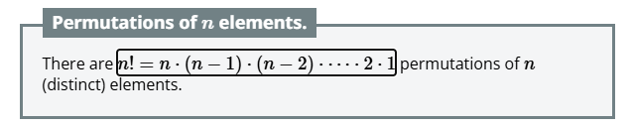
Permutations
A permutation is an arrangement in a definite order of a number of objects taken some or all at a time.
For example, there are 6 permutations of the letters a, b, c:
abc, acb, bac, bca, cab, cba
Factorial notation - n!
How many permutations are there of the letters a, b, c, d, e, f ?

Slide 6
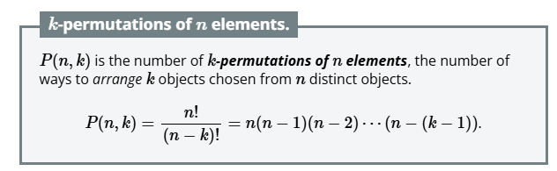
Permutations
Arrangements: how many permutations exist of k objects choosing those objects from a larger collection of n objects.
How many 4 letter “words” can you make from the letters a through f, with no repeated letters?

Slide 7
Permutations without repetition
The number of permutations of n different objects taken r at a time, where repetition is allowed, is nP_{r} .
How many 4-digit numbers can be formed by using the digits 1 to 9 if repetition of digits is not allowed?
How many different 7-digit phone numbers can be formed if the first digit cannot be 0 or 1, and no digit can be repeated?

Slide 8
Permutations with repetition
The number of permutations of n objects, where p objects are of the same kind and rest are all different = n!/ p! .
The number of permutations of n objects, where p₁ objects are of one kind, p₂ are of second kind, ..., p_{k} are of k^{th} kind and the rest, if any, are of different kind is n!/ p₁! p₂! ... p_{k}!.
Find how many different arrangements are possible with letters of the word ROOTS.
Find the number of different 8-letter arrangements that can be made from the letters of the word DAUGHTER so that (i) all vowels occur together (ii) all vowels do not occur together.

Slide 9
Permutations
Find the number of permutations of the letters of the word ALLAHABAD
How many numbers lying between 100 and 1000 can be formed with the digits 0, 1, 2, 3, 4, 5, if the repetition of the digits is not allowed?
Find the number of arrangements of the letters of the word INDEPENDENCE. In how many of these arrangements,
(i) do the words start with P
(ii) do all the vowels always occur together
(iii) do the vowels never occur together
(iv) do the words begin with I and end in P?

Slide 10
Permutations with repetitions allowed
When arranging r objects from n available symbols, if repetition is allowed and each position can contain any of the n symbols, the total number of possible sequences is n^{r}
A student creates a PIN consisting of 6 digits. Each digit can be any digit from 0 to 9. How many different PINs are possible?
A computer system requires a password of 8 characters, with each character selected from the 26 lowercase English letters. Assuming repetition is allowed, how many passwords are possible?
How many 7-letter strings can be formed using the English alphabet if repetition is allowed and every string must begin with A?
A username consists of 3 lowercase letters followed by 2 digits. Repetition is allowed, but the first letter must be a vowel (a, e, i, o, or u). Find the number of possible usernames.

Slide 11
Combinations
A combination is a selection of objects from a collection in which the order of selection does not matter.
For example, consider selecting two students from A, B, and C.
The possible selections are:
  A and B
  A and C
  B and C
There are three combinations.
The selection AB is the same as BA because both contain the same two students.

Slide 12

Combinations
Selecting r objects from n distinct objects is
A group of eight students is available. How many different teams of three students can be formed?
A student has seven different books and wishes to select four of them. In how many different ways can this be done ?
A department has six faculty members, including two professors. How many committees of three faculty members can be formed if both professors must be included?

Slide 13
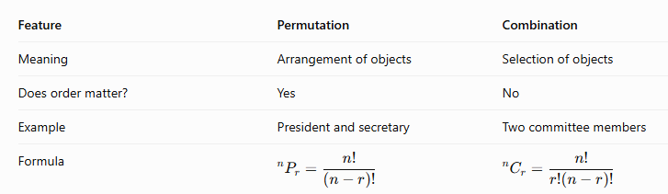

Relationship between Permutations and Combinations

Slide 14






Combinations – Properties
Property 1: Selecting Zero Objects
Property 2: Selecting All Objects
Property 3: Selecting One Object
Property 4: Symmetry Property
Property 5: Pascal's Identity
Property 6: Sum of All Combinations

Slide 15
Combinations
A group contains five boys and four girls. How many committees of three students can be formed with at least one girl?
A machine-learning model has 10 available features. How many different subsets of three features can be selected?
A network has six computers. If every pair of computers can be connected by one direct link, how many possible links are there?
A class has 8 boys and 5 girls. How many committees of 4 students can be formed?
How many committees of 4 can be formed from 6 men and 5 women if at least one woman must be included?
A bag contains 5 black and 6 red balls. Determine the number of ways in which 2 black and 3 red balls can be selected.
How many words, with or without meaning, each of 3 vowels and 2 consonants can be formed from the letters of the word INVOLUTE ?

Slide 16
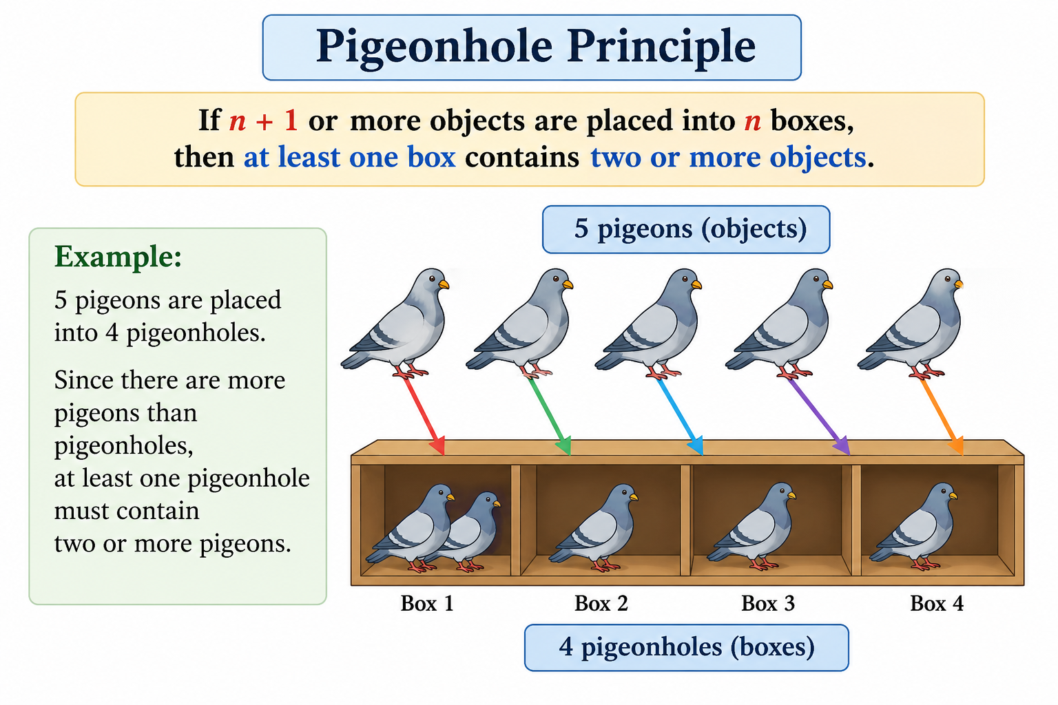
Show that among 13 people, at least two people must have their birthdays in the same month.

Slide 17

Generalized Pigeonhole Principle
If N objects are distributed among k boxes, then at least one box contains at least
Example: A class has 47 MCA students divided into 8 tutorial groups. Prove that at least one group contains at least 6 students.
What is the minimum number of students required to guarantee that at least 5 students have birthdays in the same month?

Slide 18
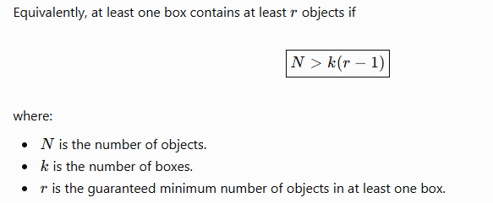
Generalized Pigeonhole Principle
1. There are 8 students and 7 chairs. If each student occupies one chair, show that at least one chair must be shared if all students are seated.
2. What is the minimum number of people required to guarantee that at least two people were born on the same day of the week?
3. A bag contains balls in 5 different colours. What is the minimum number of balls that must be selected to guarantee at least two of the same colour?
To guarantee that at least r objects are in the same one of k boxes, the minimum required number of objects is k(r-1) + 1

Slide 19
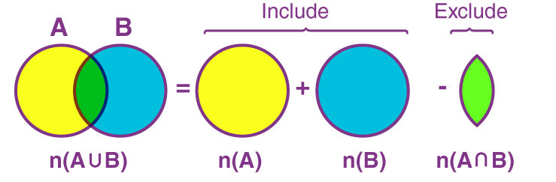
Inclusion–Exclusion Principle
Two-set formula - n(A⋃B) = n(A) + n(B) – n(A⋂B)
In a survey of 80 students, 50 use Android phones and 45 use iPhones. Assume each student uses at least one of these types of phones. How many students use both?

Slide 20
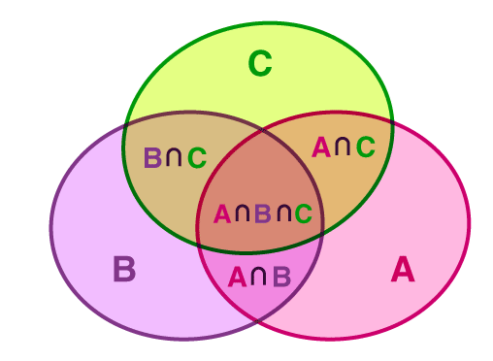
Inclusion–Exclusion Principle
Three set formula:
  n(A⋃B⋃C) = n(A) + n(B) + n(C) – n(A⋂B) – n(A⋂C) – n(B⋂C) + n(A⋂B⋂C)
In a survey of 100 students, the following information was collected 50 know Python, 45 know Java, 40 know C++, 20 know both Python and Java, 18 know both Python and C++, 15 know both Java and C++, 8 know all three languages. Find the number of students who know at least one of the three languages.

Slide 21
Inclusion–Exclusion Principle
Elements belonging to exactly two sets
Elements belonging to exactly one set

Slide 22
Inclusion–Exclusion Principle
In a survey of 120 people 80 people like tea, 70 people like coffee, 50 people like both tea and coffee. How many people like either tea or coffee?
A company has 30 employees, 10 are assigned to Task A, 15 to Task B, and 5 are assigned to both. How many employees are assigned to at least one task?
In a survey of 200 people 120 likes pizza, 100 like burgers, 80 like tacos, 60 likes both pizza and burgers, 40 likes both burgers and tacos, 30 likes both pizza and tacos,20 likes all three: pizza, burgers, and tacos.
  How many people like at least one of these three foods?
  How many people liked exactly two foods?
In a class 35 students study Statistics, 28 students study Discrete Mathematics, 12 students study both subjects.
Find:
  The number studying at least one subject.
  The number studying only Statistics.
  The number studying only Discrete Mathematics.
  The number studying exactly one subject.
5. How many integers from 1 to 100 are divisible by 2 or 5?
6. Suppose a system generates three-digit strings using digits 0–9, allowing leading zeros and repeated digits. How many strings contain at least one digit 0 or at least one digit 5?

Slide 23
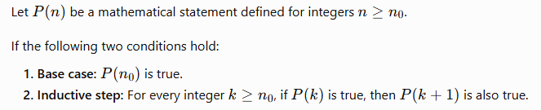
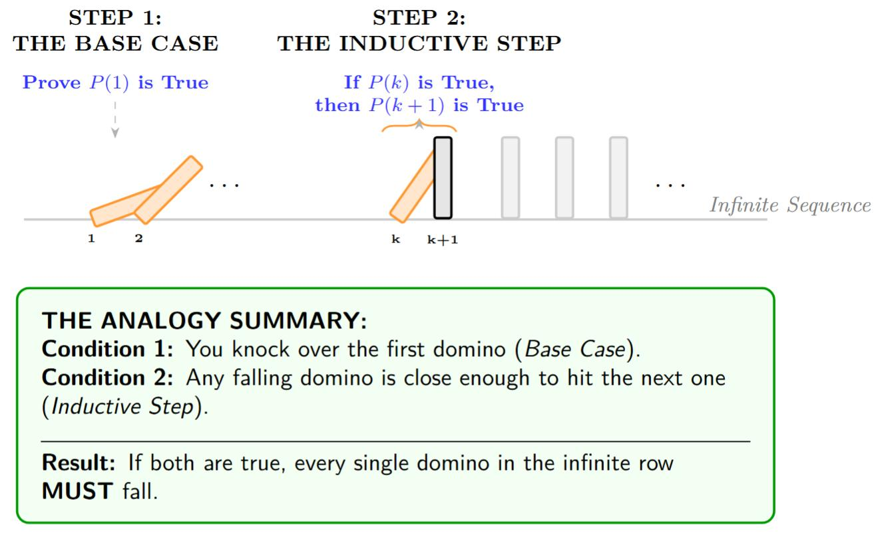
Mathematical Induction
Mathematical Induction is a mathematical technique which is used to prove a statement, a formula or a theorem is true for every natural number.
Principle of induction:

Slide 24
Components of an Inductive Proof
Step 1: State the proposition
Write the statement P(n) that must be proved.
Step 2: Establish the base case
Substitute the smallest permitted value, usually n=1, into the statement.
Verify that both sides are equal.
Step 3: State the inductive hypothesis
Assume the proposition is true for an arbitrary integer k≥n₀
Step 4: Prove the inductive step
Using the inductive hypothesis, prove that the statement is true for k+1.
P(k)→ P(k+1)
Once the base case and inductive step are established, conclude that the proposition holds for all integers in the specified range.

Slide 25

Prove by mathematical induction that for all integers n≥1

Slide 26

Prove by mathematical induction that for all integers n≥1

Slide 27

Prove by mathematical induction that for all integers n≥1

Slide 28
For any positive integer n, prove that n³ + 2n is always divisible by 3

Slide 29
THANK YOU

